Slide 1

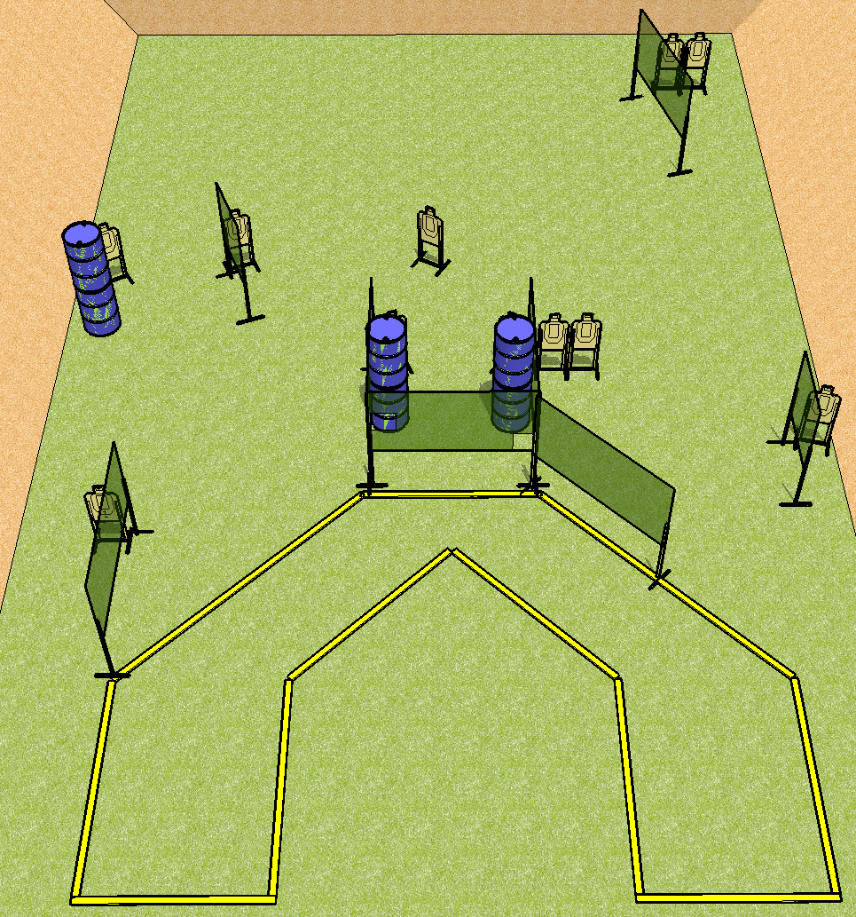
 | Dothan Practical Shooters – USPSA Match Clever Name Course Designer : Andrew Hobbs Bay: A1
Round Count 22 rounds 11 USPSA
Equipment List 12 wall feet

Slide 2
Clever Name
Written Stage Briefing
Scoring: Comstock Rounds: 22
Targets: 11 USPSA
Handgun start position: anywhere inside the shooting area, wrists below belt. Handgun is loaded and holstered.
PCC start position: anywhere inside the shooting area, stock on belt. Loaded carbine is held with both hands, safety on.
Stage Procedure: on the audible start signal, engage targets as they become available from within the shooting area.

